Slide 1
Machine Learning
+
Programme Grant Update Science Talk

Slide 2


Machine Learning Overview
Notes:
Trim down each point

Slide 3
Supervised Machine Learning
General Idea:
Given a dataset with known labels …
“Train” a machine learning model using the dataset …
Then used the trained model to make predictions for new data which do not have labels
Notes:
Trim down each point

Slide 4
Supervised Machine Learning
Methods:
Regression
Random Forests, Support Vector Machines, K-Nearest Neighbor
Deep Learning (Neural Networks)
Notes:
Trim down each point

Slide 5
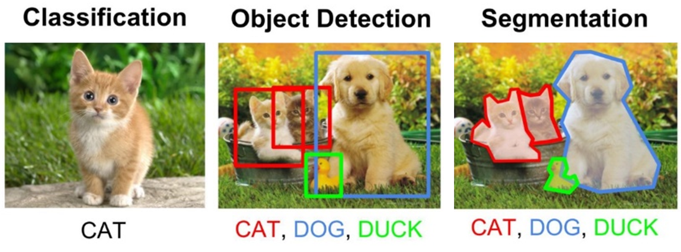
Types of Supervised Learning Tasks
Image related tasks are the most common problems for machine learning
Notes:
Trim down each point

Slide 6

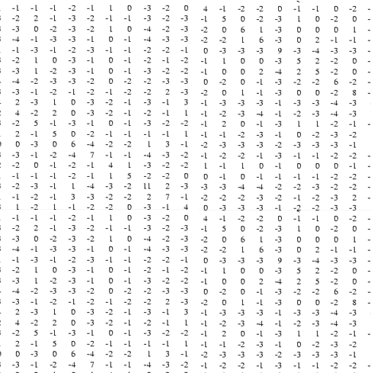
Why These Tasks are Difficult?
What we see:
What the computer “sees”:
It is difficult to come up with a set of “strict rules” to define image content
Such tasks require the use of more sophisticated learning algorithms
Notes:
Trim down each point

Slide 7
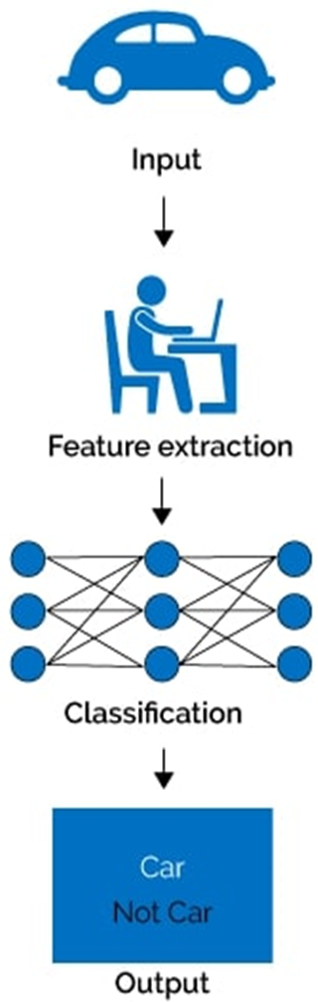
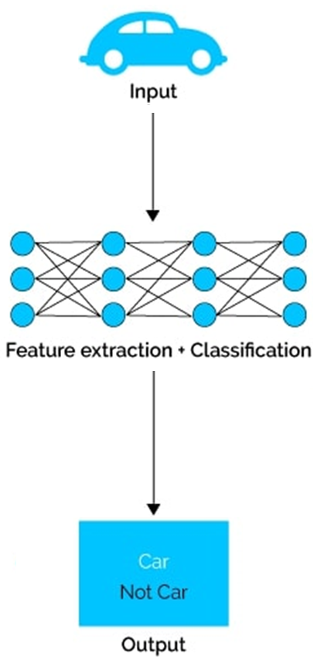
Machine Learning vs Deep Learning
Machine Learning
Deep Learning
Notes:
Trim down each point

Slide 8
Neural Network Types
Simple Neural Networks:
Used on 1-Dimensional Data
Convolutional Neural Networks:
Used on 2D or 3D Data (Images, Volumes, Videos)
Recurrent Neural Networks:
Used on Sequential Data (Text, Time-Series)
Notes:
Trim down each point

Slide 9
Neural Network Types
Simple Neural Networks:
Used on 1-Dimensional Data
Convolutional Neural Networks:
Used on 2D or 3D Data (Images, Volumes, Videos)
Recurrent Neural Networks:
Used on Sequential Data (Text, Time-Series)
Notes:
Trim down each point

Slide 10
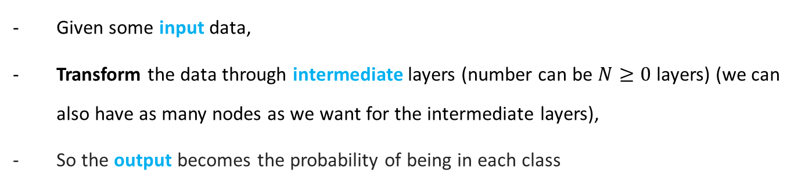
Introducing Neural Networks
Intermediate layers
Input
Output (prediction)
72% Class 1
28% Class 2
Given some input data,
Transform the data through intermediate layers (number can be $N≥0$ layers) (we can also have as many nodes as we want for the intermediate layers),
So the output becomes the probability of being in each class
Notes:
https://docs.google.com/presentation/d/1XuyiyjRngEk5juZzX8NNos8VQp2_pcqvhIcfUi79yDI/edit#slide=id.i0

Slide 11
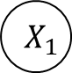
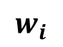
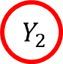

How Transformations are Performed?
Starting with a (very) simple neural network:
Input
(1 node)
Output
(2 nodes)
$$w_{i}$$
$$Y_{1}$$
Positive
$$X_{1}$$
$$Y_{2}$$
Negative
Notes:
https://docs.google.com/presentation/d/1XuyiyjRngEk5juZzX8NNos8VQp2_pcqvhIcfUi79yDI/edit#slide=id.i0

Slide 12
How Transformations are Performed?
Starting with a (very) simple neural network:
Input
(1 node)
Output
(2 nodes)
$$w_{i}$$
$$Y_{1}$$
Positive
$$X_{1}$$
$$Y_{2}$$
Negative
TASK: given a single number at the input (X₁), predict if its positive or negative (at the output, Y).
Notes:
https://docs.google.com/presentation/d/1XuyiyjRngEk5juZzX8NNos8VQp2_pcqvhIcfUi79yDI/edit#slide=id.i0

Slide 13
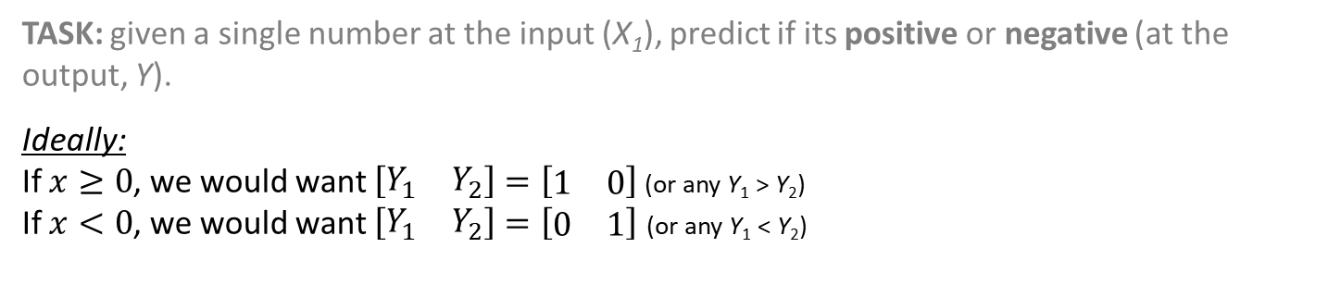
How Transformations are Performed?
Starting with a (very) simple neural network:
Input
(1 node)
Output
(2 nodes)
$$w_{i}$$
$$Y_{1}$$
Positive
$$X_{1}$$
$$Y_{2}$$
Negative
TASK: given a single number at the input (X₁), predict if its positive or negative (at the output, Y).
Ideally:
If $x≥0$, we would want $\left[\begin{matrix}Y_{1} & Y_{2}\end{matrix}\right]=\left[\begin{matrix}1 & 0\end{matrix}\right]$ (or any Y₁ > Y₂)
If $x<0$, we would want $\left[\begin{matrix}Y_{1} & Y_{2}\end{matrix}\right]=\left[\begin{matrix}0 & 1\end{matrix}\right]$ (or any Y₁ < Y₂)
Notes:
https://docs.google.com/presentation/d/1XuyiyjRngEk5juZzX8NNos8VQp2_pcqvhIcfUi79yDI/edit#slide=id.i0

Slide 14
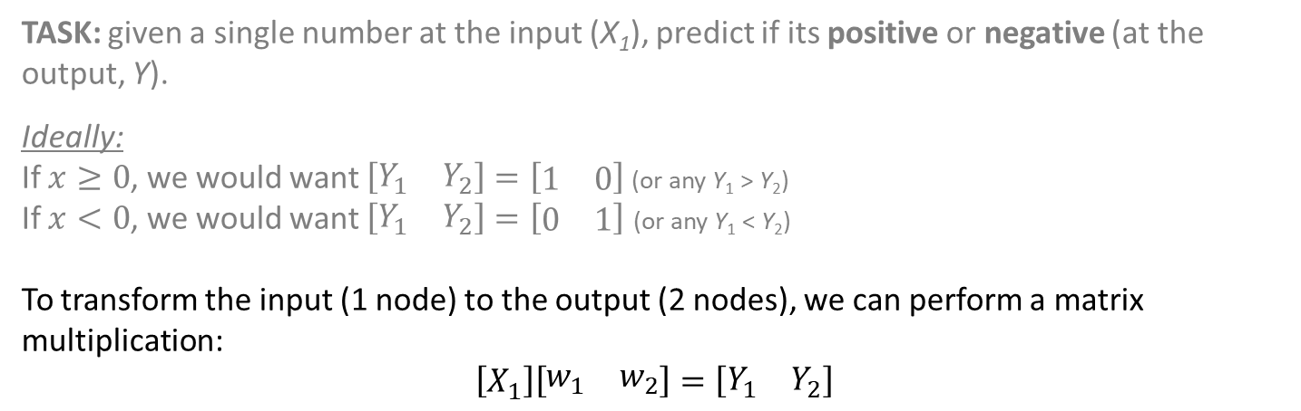
How Transformations are Performed?
Starting with a (very) simple neural network:
Input
(1 node)
Output
(2 nodes)
$$w_{i}$$
$$Y_{1}$$
Positive
$$X_{1}$$
$$Y_{2}$$
Negative
TASK: given a single number at the input (X₁), predict if its positive or negative (at the output, Y).
Ideally:
If $x≥0$, we would want $\left[\begin{matrix}Y_{1} & Y_{2}\end{matrix}\right]=\left[\begin{matrix}1 & 0\end{matrix}\right]$ (or any Y₁ > Y₂)
If $x<0$, we would want $\left[\begin{matrix}Y_{1} & Y_{2}\end{matrix}\right]=\left[\begin{matrix}0 & 1\end{matrix}\right]$ (or any Y₁ < Y₂)
To transform the input (1 node) to the output (2 nodes), we can perform a matrix multiplication: $$\left[X_{1}\right]\left[\begin{matrix}w_{1} & w_{2}\end{matrix}\right]=\left[\begin{matrix}Y_{1} & Y_{2}\end{matrix}\right]$$
Notes:
https://docs.google.com/presentation/d/1XuyiyjRngEk5juZzX8NNos8VQp2_pcqvhIcfUi79yDI/edit#slide=id.i0

Slide 15


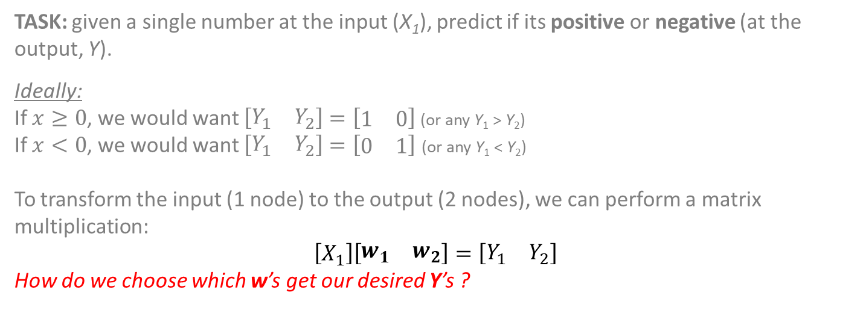
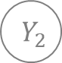

How Transformations are Performed?
Starting with a (very) simple neural network:
Input
(1 node)
Output
(2 nodes)
$$w_{i}$$
$$Y_{1}$$
Positive
$$X_{1}$$
$$Y_{2}$$
Negative
TASK: given a single number at the input (X₁), predict if its positive or negative (at the output, Y).
Ideally:
If $x≥0$, we would want $\left[\begin{matrix}Y_{1} & Y_{2}\end{matrix}\right]=\left[\begin{matrix}1 & 0\end{matrix}\right]$ (or any Y₁ > Y₂)
If $x<0$, we would want $\left[\begin{matrix}Y_{1} & Y_{2}\end{matrix}\right]=\left[\begin{matrix}0 & 1\end{matrix}\right]$ (or any Y₁ < Y₂)
To transform the input (1 node) to the output (2 nodes), we can perform a matrix multiplication: $$\left[X_{1}\right]\left[\begin{matrix}w_{1} & w_{2}\end{matrix}\right]=\left[\begin{matrix}Y_{1} & Y_{2}\end{matrix}\right]$$
How do we choose which w’s get our desired Y’s ?
Notes:
https://docs.google.com/presentation/d/1XuyiyjRngEk5juZzX8NNos8VQp2_pcqvhIcfUi79yDI/edit#slide=id.i0

Slide 16
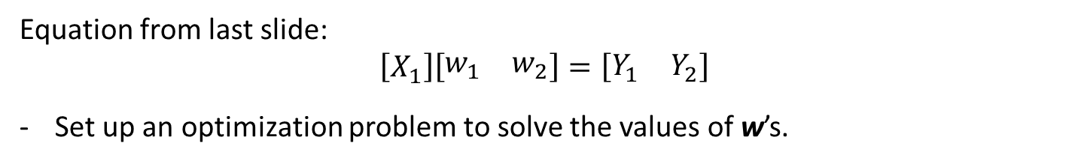
Training the Neural Network – An Optimization Problem
Equation from last slide: $$\left[X_{1}\right]\left[\begin{matrix}w_{1} & w_{2}\end{matrix}\right]=\left[\begin{matrix}Y_{1} & Y_{2}\end{matrix}\right]$$
Set up an optimization problem to solve the values of w’s.
Notes:
https://docs.google.com/presentation/d/1XuyiyjRngEk5juZzX8NNos8VQp2_pcqvhIcfUi79yDI/edit#slide=id.i0

Slide 17
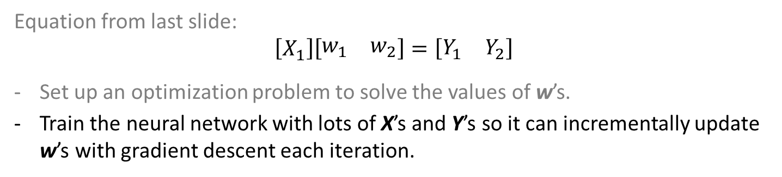
Training the Neural Network – An Optimization Problem
Equation from last slide: $$\left[X_{1}\right]\left[\begin{matrix}w_{1} & w_{2}\end{matrix}\right]=\left[\begin{matrix}Y_{1} & Y_{2}\end{matrix}\right]$$
Set up an optimization problem to solve the values of w’s.
Train the neural network with lots of X’s and Y’s so it can incrementally update w’s with gradient descent each iteration.
Notes:
https://docs.google.com/presentation/d/1XuyiyjRngEk5juZzX8NNos8VQp2_pcqvhIcfUi79yDI/edit#slide=id.i0

Slide 18
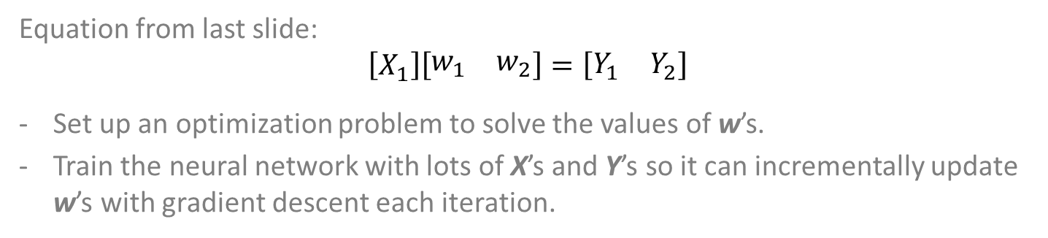
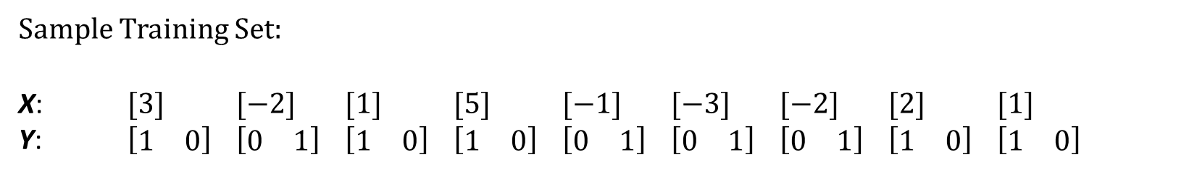
Training the Neural Network – An Optimization Problem
Equation from last slide: $$\left[X_{1}\right]\left[\begin{matrix}w_{1} & w_{2}\end{matrix}\right]=\left[\begin{matrix}Y_{1} & Y_{2}\end{matrix}\right]$$
Set up an optimization problem to solve the values of w’s.
Train the neural network with lots of X’s and Y’s so it can incrementally update w’s with gradient descent each iteration.
Sample Training Set:
X: $[3]$ $[−2]$ $[1]$ $[5]$ $[−1]$ $[−3]$ $[−2]$ $[2]$ $[1]$
Y: $\left[\begin{matrix}1 & 0\end{matrix}\right]$ $\left[\begin{matrix}0 & 1\end{matrix}\right]$ $\left[\begin{matrix}1 & 0\end{matrix}\right]$ $\left[\begin{matrix}1 & 0\end{matrix}\right]$ $\left[\begin{matrix}0 & 1\end{matrix}\right]$ $\left[\begin{matrix}0 & 1\end{matrix}\right]$ $\left[\begin{matrix}0 & 1\end{matrix}\right]$ $\left[\begin{matrix}1 & 0\end{matrix}\right]$ $\left[\begin{matrix}1 & 0\end{matrix}\right]$
Notes:
https://docs.google.com/presentation/d/1XuyiyjRngEk5juZzX8NNos8VQp2_pcqvhIcfUi79yDI/edit#slide=id.i0

Slide 19
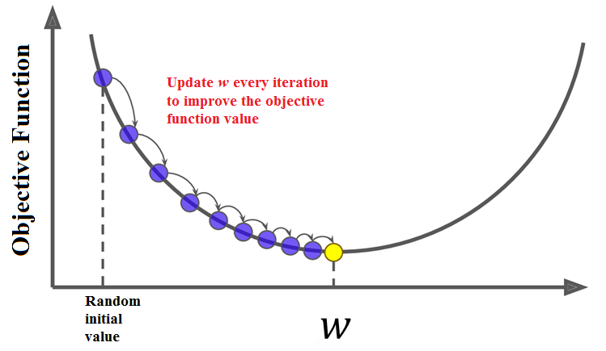
Training the Neural Network – An Optimization Problem
Equation from last slide: $$\left[X_{1}\right]\left[\begin{matrix}w_{1} & w_{2}\end{matrix}\right]=\left[\begin{matrix}Y_{1} & Y_{2}\end{matrix}\right]$$
Set up an optimization problem to solve the values of w’s.
Train the neural network with lots of X’s and Y’s so it can incrementally update w’s with gradient descent each iteration.
Notes:
https://docs.google.com/presentation/d/1XuyiyjRngEk5juZzX8NNos8VQp2_pcqvhIcfUi79yDI/edit#slide=id.i0

Slide 20
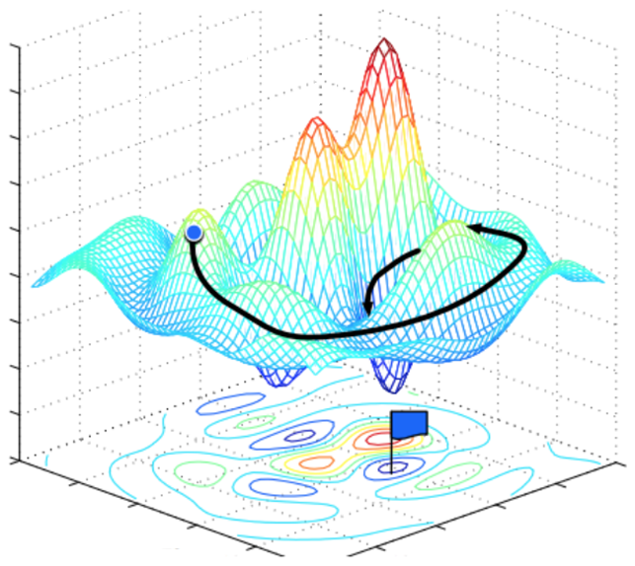
Training the Neural Network – An Optimization Problem
Equation from last slide: $$\left[X_{1}\right]\left[\begin{matrix}w_{1} & w_{2}\end{matrix}\right]=\left[\begin{matrix}Y_{1} & Y_{2}\end{matrix}\right]$$
Set up an optimization problem to solve the values of w’s.
Train the neural network with lots of X’s and Y’s so it can incrementally update w’s with gradient descent each iteration.
Notes:
https://docs.google.com/presentation/d/1XuyiyjRngEk5juZzX8NNos8VQp2_pcqvhIcfUi79yDI/edit#slide=id.i0

Slide 21
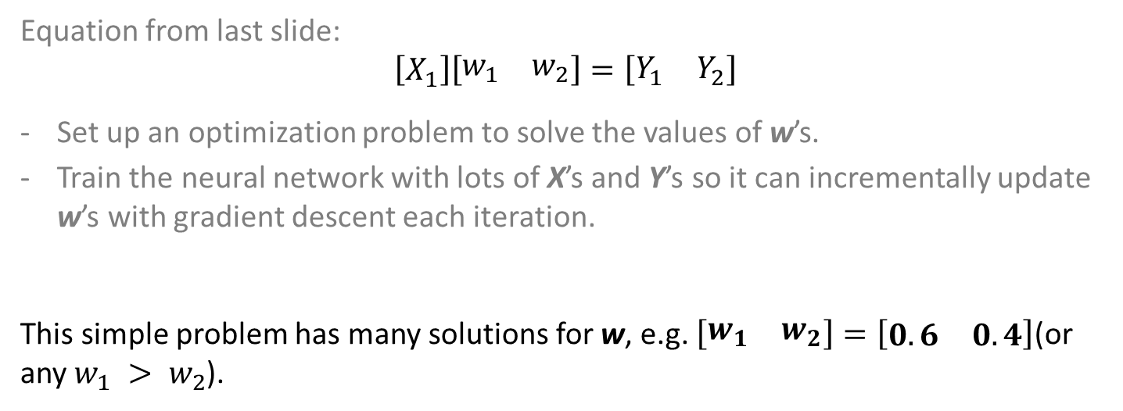
Training the Neural Network – An Optimization Problem
Equation from last slide: $$\left[X_{1}\right]\left[\begin{matrix}w_{1} & w_{2}\end{matrix}\right]=\left[\begin{matrix}Y_{1} & Y_{2}\end{matrix}\right]$$
Set up an optimization problem to solve the values of w’s.
Train the neural network with lots of X’s and Y’s so it can incrementally update w’s with gradient descent each iteration.
This simple problem has many solutions for w, e.g. $\left[\begin{matrix}w_{1} & w_{2}\end{matrix}\right]=\left[\begin{matrix}0.6 & 0.4\end{matrix}\right]$(or any $w_{1} > w_{2}$).
Notes:
https://docs.google.com/presentation/d/1XuyiyjRngEk5juZzX8NNos8VQp2_pcqvhIcfUi79yDI/edit#slide=id.i0

Slide 22
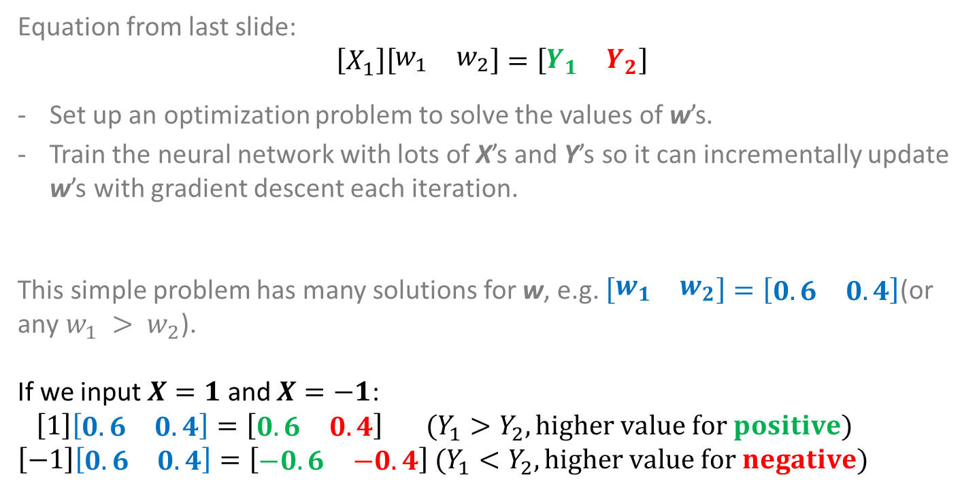
Training the Neural Network – An Optimization Problem
Equation from last slide: $$\left[X_{1}\right]\left[\begin{matrix}w_{1} & w_{2}\end{matrix}\right]=\left[\begin{matrix}Y_{1} & Y_{2}\end{matrix}\right]$$
Set up an optimization problem to solve the values of w’s.
Train the neural network with lots of X’s and Y’s so it can incrementally update w’s with gradient descent each iteration.
This simple problem has many solutions for w, e.g. $\left[\begin{matrix}w_{1} & w_{2}\end{matrix}\right]=\left[\begin{matrix}0.6 & 0.4\end{matrix}\right]\text{(}\text{or} \text{any} w_{1} > w_{2}\text{).}$
If we input $X=1$ and $X=−1$:
$\left[1\right]\left[\begin{matrix}0.6 & 0.4\end{matrix}\right]=\left[\begin{matrix}0.6 & 0.4\end{matrix}\right]$ $(Y_{1}>Y_{2}, higher value for positive)$
$\left[−1\right]\left[\begin{matrix}0.6 & 0.4\end{matrix}\right]=\left[\begin{matrix}−0.6 & −0.4\end{matrix}\right]$ $(Y_{1}<Y_{2}, higher value for negative)$
Notes:
https://docs.google.com/presentation/d/1XuyiyjRngEk5juZzX8NNos8VQp2_pcqvhIcfUi79yDI/edit#slide=id.i0

Slide 23
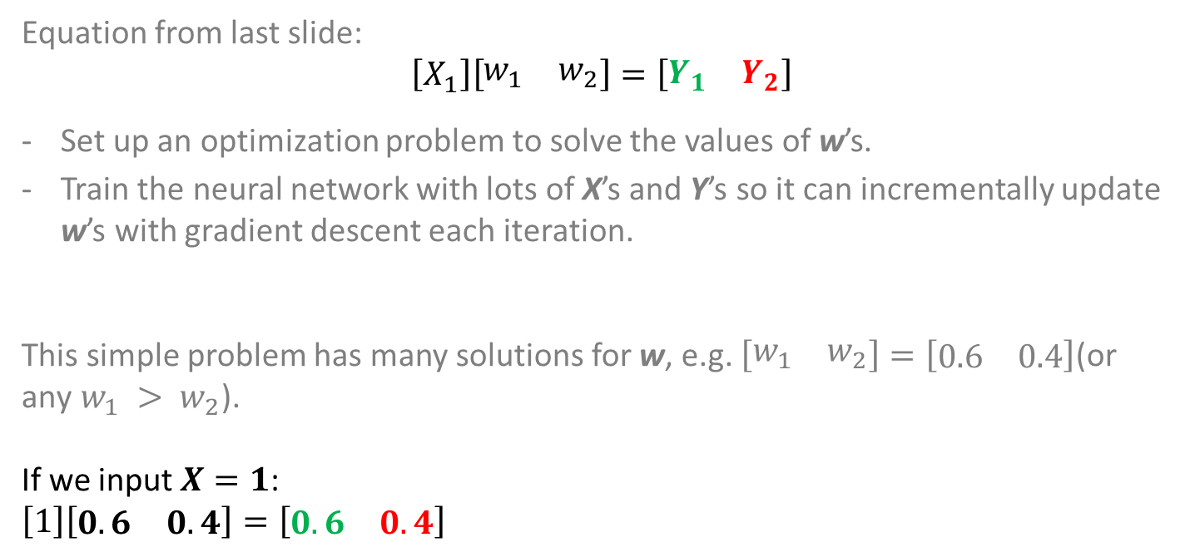
Training the Neural Network – An Optimization Problem
Equation from last slide: $$\left[X_{1}\right]\left[\begin{matrix}w_{1} & w_{2}\end{matrix}\right]=\left[\begin{matrix}Y_{1} & Y_{2}\end{matrix}\right]$$
Set up an optimization problem to solve the values of w’s.
Train the neural network with lots of X’s and Y’s so it can incrementally update w’s with gradient descent each iteration.
This simple problem has many solutions for w, e.g. $\left[\begin{matrix}w_{1} & w_{2}\end{matrix}\right]=\left[\begin{matrix}0.6 & 0.4\end{matrix}\right]\text{(}\text{or} \text{any} w_{1} > w_{2}\text{).}$
If we input $X=1$:
$\left[1\right]\left[\begin{matrix}0.6 & 0.4\end{matrix}\right]=\left[\begin{matrix}0.6 & 0.4\end{matrix}\right]$
Notes:
https://docs.google.com/presentation/d/1XuyiyjRngEk5juZzX8NNos8VQp2_pcqvhIcfUi79yDI/edit#slide=id.i0

Slide 24
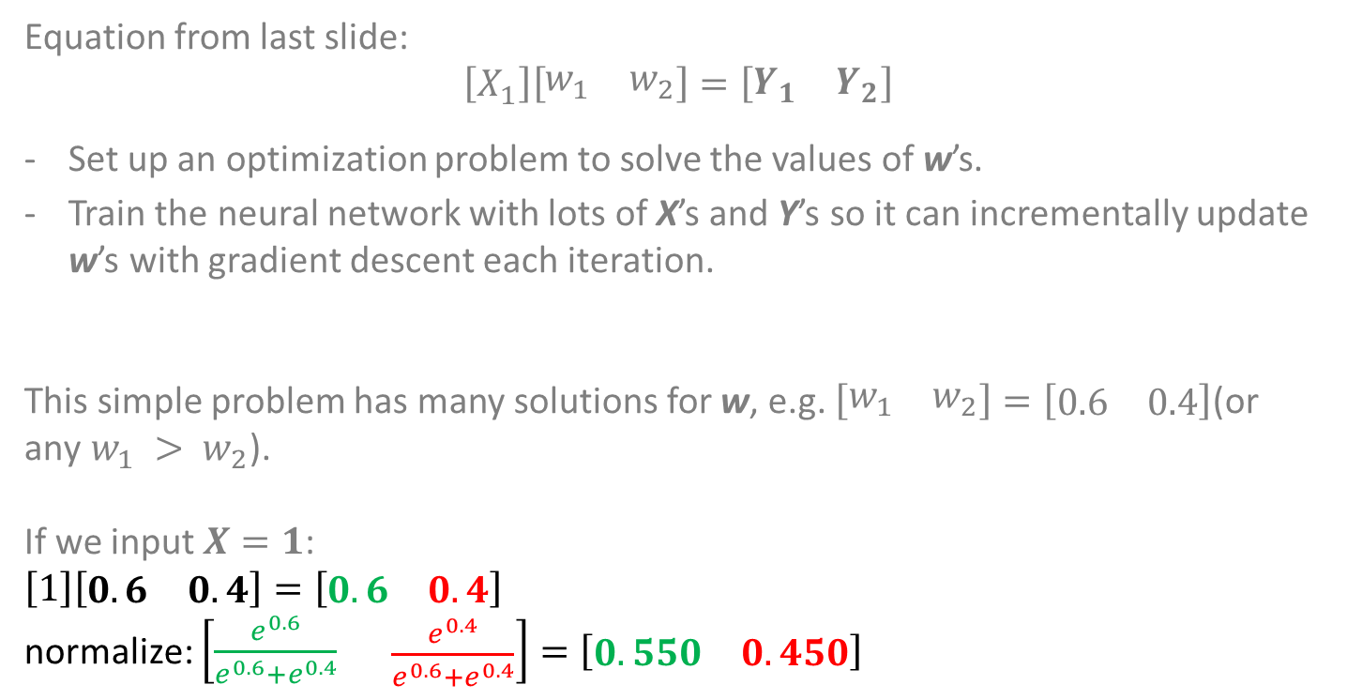
Training the Neural Network – An Optimization Problem
Equation from last slide: $$\left[X_{1}\right]\left[\begin{matrix}w_{1} & w_{2}\end{matrix}\right]=\left[\begin{matrix}Y_{1} & Y_{2}\end{matrix}\right]$$
Set up an optimization problem to solve the values of w’s.
Train the neural network with lots of X’s and Y’s so it can incrementally update w’s with gradient descent each iteration.
This simple problem has many solutions for w, e.g. $\left[\begin{matrix}w_{1} & w_{2}\end{matrix}\right]=\left[\begin{matrix}0.6 & 0.4\end{matrix}\right]\text{(}\text{or} \text{any} w_{1} > w_{2}\text{).}$
If we input $X=1$:
$\left[1\right]\left[\begin{matrix}0.6 & 0.4\end{matrix}\right]=\left[\begin{matrix}0.6 & 0.4\end{matrix}\right]$
normalize: $\left[\frac{e^{0.6}}{e^{0.6}+e^{0.4}}\begin{matrix} & \frac{e^{0.4}}{e^{0.6}+e^{0.4}}\end{matrix}\right]=\left[\begin{matrix}0.550 & 0.450\end{matrix}\right]$
Notes:
https://docs.google.com/presentation/d/1XuyiyjRngEk5juZzX8NNos8VQp2_pcqvhIcfUi79yDI/edit#slide=id.i0

Slide 25
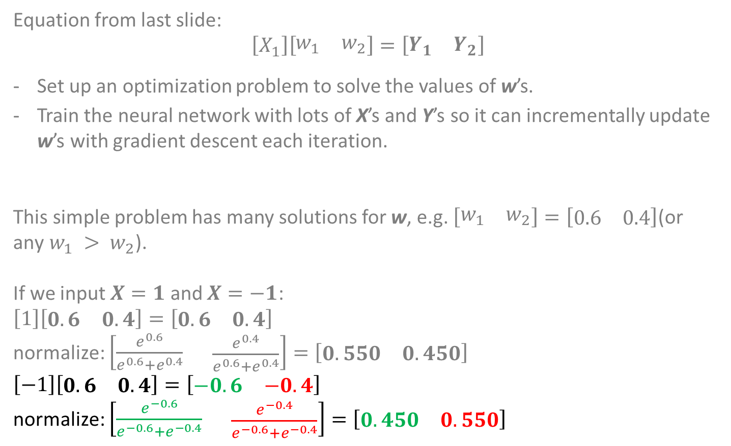
Training the Neural Network – An Optimization Problem
Equation from last slide: $$\left[X_{1}\right]\left[\begin{matrix}w_{1} & w_{2}\end{matrix}\right]=\left[\begin{matrix}Y_{1} & Y_{2}\end{matrix}\right]$$
Set up an optimization problem to solve the values of w’s.
Train the neural network with lots of X’s and Y’s so it can incrementally update w’s with gradient descent each iteration.
This simple problem has many solutions for w, e.g. $\left[\begin{matrix}w_{1} & w_{2}\end{matrix}\right]=\left[\begin{matrix}0.6 & 0.4\end{matrix}\right]\text{(}\text{or} \text{any} w_{1} > w_{2}\text{).}$
If we input $X=1$ and $X=−1$:
$\left[1\right]\left[\begin{matrix}0.6 & 0.4\end{matrix}\right]=\left[\begin{matrix}0.6 & 0.4\end{matrix}\right]$
normalize: $\left[\frac{e^{0.6}}{e^{0.6}+e^{0.4}}\begin{matrix} & \frac{e^{0.4}}{e^{0.6}+e^{0.4}}\end{matrix}\right]=\left[\begin{matrix}0.550 & 0.450\end{matrix}\right]$
$\left[−1\right]\left[\begin{matrix}0.6 & 0.4\end{matrix}\right]=\left[\begin{matrix}−0.6 & −0.4\end{matrix}\right]$
normalize: $\left[\frac{e^{−0.6}}{e^{−0.6}+e^{−0.4}}\begin{matrix} & \frac{e^{−0.4}}{e^{−0.6}+e^{−0.4}}\end{matrix}\right]=\left[\begin{matrix}0.450 & 0.550\end{matrix}\right]$
Notes:
https://docs.google.com/presentation/d/1XuyiyjRngEk5juZzX8NNos8VQp2_pcqvhIcfUi79yDI/edit#slide=id.i0

Slide 26
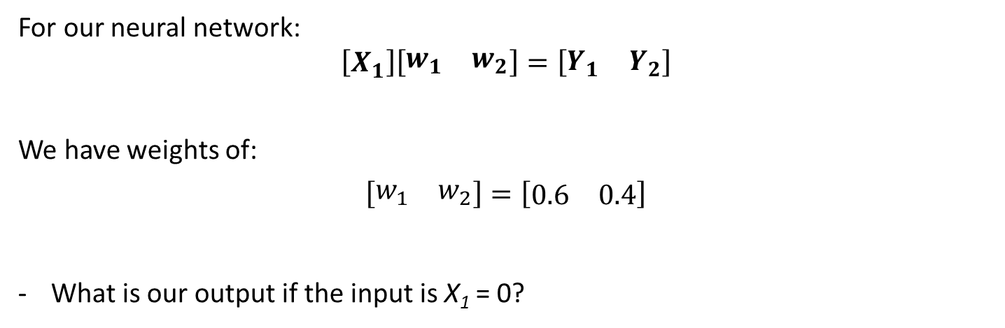
Question?
For our neural network: $$\left[X_{1}\right]\left[\begin{matrix}w_{1} & w_{2}\end{matrix}\right]=\left[\begin{matrix}Y_{1} & Y_{2}\end{matrix}\right]$$
We have weights of:
$$\left[\begin{matrix}w_{1} & w_{2}\end{matrix}\right]=\left[\begin{matrix}0.6 & 0.4\end{matrix}\right]$$
What is our output if the input is X₁ = 0?
Notes:
https://docs.google.com/presentation/d/1XuyiyjRngEk5juZzX8NNos8VQp2_pcqvhIcfUi79yDI/edit#slide=id.i0

Slide 27
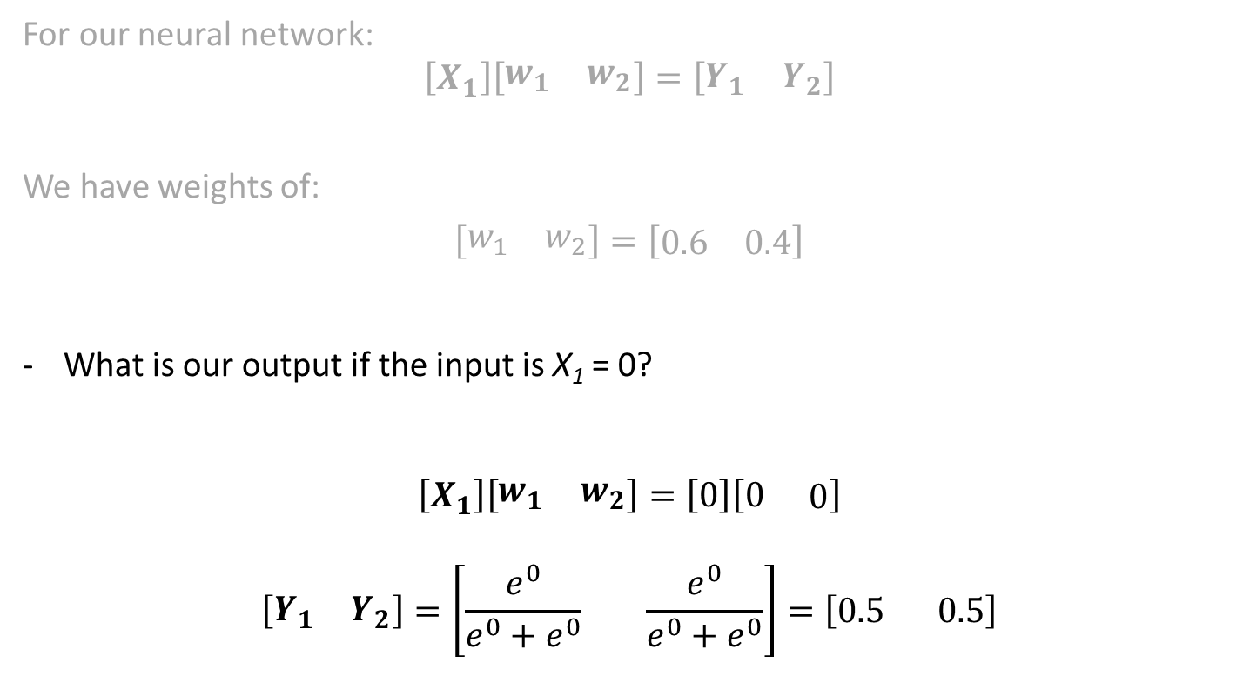
Question?
For our neural network: $$\left[X_{1}\right]\left[\begin{matrix}w_{1} & w_{2}\end{matrix}\right]=\left[\begin{matrix}Y_{1} & Y_{2}\end{matrix}\right]$$
We have weights of:
$$\left[\begin{matrix}w_{1} & w_{2}\end{matrix}\right]=\left[\begin{matrix}0.6 & 0.4\end{matrix}\right]$$
What is our output if the input is X₁ = 0?
$$\left[X_{1}\right]\left[\begin{matrix}w_{1} & w_{2}\end{matrix}\right]=\left[0\right]\left[0\begin{matrix} & 0\end{matrix}\right]$$
$$\left[\begin{matrix}Y_{1} & Y_{2}\end{matrix}\right]=\left[\frac{e^{0}}{e^{0}+e^{0}}\begin{matrix} & \end{matrix}\frac{e^{0}}{e^{0}+e^{0}}\right]=\left[0.5\begin{matrix} & \end{matrix}0.5\right]$$
Notes:
https://docs.google.com/presentation/d/1XuyiyjRngEk5juZzX8NNos8VQp2_pcqvhIcfUi79yDI/edit#slide=id.i0

Slide 28
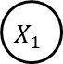
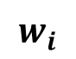
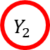
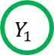
Coding the Example in Python
Input
Output
# import the packages we will be needing
import tflearn
$$Y_{1}$$
Positive
$$X_{1}$$
$$w_{i}$$
$$Y_{2}$$
Negative
Notes:
https://docs.google.com/presentation/d/1XuyiyjRngEk5juZzX8NNos8VQp2_pcqvhIcfUi79yDI/edit#slide=id.i0

Slide 29
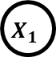



Coding the Example in Python
# import the packages we will be needing
import tflearn
# define the input layer (1 node)
X_i = tflearn.input_data(shape=[None, 1])
Input
Output
$$Y_{1}$$
Positive
$$X_{1}$$
$$w_{i}$$
$$Y_{2}$$
Negative
Notes:
https://docs.google.com/presentation/d/1XuyiyjRngEk5juZzX8NNos8VQp2_pcqvhIcfUi79yDI/edit#slide=id.i0

Slide 30
Coding the Example in Python
Input
Output
# import the packages we will be needing
import tflearn
# define the input layer (1 node)
X_i = tflearn.input_data(shape=[None, 1])
# define the output layer (2 nodes), softmax normalizes values between 0/1
Y_j = tflearn.fully_connected(X_i, n_units=2, activation='softmax')
$$Y_{1}$$
Positive
$$X_{1}$$
$$w_{i}$$
$$Y_{2}$$
Negative
Notes:
https://docs.google.com/presentation/d/1XuyiyjRngEk5juZzX8NNos8VQp2_pcqvhIcfUi79yDI/edit#slide=id.i0

Slide 31
Coding the Example in Python
Input
Output
# import the packages we will be needing
import tflearn
# define the input layer (1 node)
X_i = tflearn.input_data(shape=[None, 1])
# define the output layer (2 nodes), softmax normalizes values between 0/1
Y_j = tflearn.fully_connected(X_i, n_units=2, activation='softmax')
$$Y_{1}$$
Positive
$$X_{1}$$
$$w_{i}$$
$$Y_{2}$$
Negative
We don’t need to define w_{i}
Notes:
https://docs.google.com/presentation/d/1XuyiyjRngEk5juZzX8NNos8VQp2_pcqvhIcfUi79yDI/edit#slide=id.i0

Slide 32
Coding the Example in Python
Input
Output
# import the packages we will be needing
import tflearn
# define the input layer (1 node)
X_i = tflearn.input_data(shape=[None, 1])
# define the output layer (2 nodes), softmax normalizes values between 0/1
Y_j = tflearn.fully_connected(X_i, n_units=2, activation='softmax')
# set up optimization problem (sgd = stochastic gradient descent)
optimization_problem = tflearn.regression(Y_j, optimizer="sgd")
# initialize variables w_i with random values to provide a starting point for optimization
model = tflearn.DNN(optimization_problem)
$$Y_{1}$$
Positive
$$X_{1}$$
$$w_{i}$$
$$Y_{2}$$
Negative
Notes:
https://docs.google.com/presentation/d/1XuyiyjRngEk5juZzX8NNos8VQp2_pcqvhIcfUi79yDI/edit#slide=id.i0

Slide 33
Coding the Example in Python
Input
Output
# import the packages we will be needing
import tflearn
# define the input layer (1 node)
X_i = tflearn.input_data(shape=[None, 1])
# define the output layer (2 nodes), softmax normalizes values between 0/1
Y_j = tflearn.fully_connected(X_i, n_units=2, activation='softmax')
# set up optimization problem (sgd = stochastic gradient descent)
optimization_problem = tflearn.regression(Y_j, optimizer="sgd")
# initialize variables w_i with random values to provide a starting point for optimization
model = tflearn.DNN(optimization_problem)
# train the model (assuming we have some data) for 100 iterations, update w every iteration
model.fit(data, label, n_epoch=100)
$$Y_{1}$$
Positive
$$X_{1}$$
$$w_{i}$$
$$Y_{2}$$
Negative
Notes:
https://docs.google.com/presentation/d/1XuyiyjRngEk5juZzX8NNos8VQp2_pcqvhIcfUi79yDI/edit#slide=id.i0

Slide 34
Coding the Example in Python
Input
Output
# import the packages we will be needing
import tflearn
# define the input layer (1 node)
X_i = tflearn.input_data(shape=[None, 1])
# define the output layer (2 nodes), softmax normalizes values between 0/1
Y_j = tflearn.fully_connected(X_i, n_units=2, activation='softmax')
# set up optimization problem (sgd = stochastic gradient descent)
optimization_problem = tflearn.regression(Y_j, optimizer="sgd")
# initialize variables w_i with random values to provide a starting point for optimization
model = tflearn.DNN(optimization_problem)
# train the model (assuming we have some data) for 100 iterations, update w every iteration
model.fit(data, label, n_epoch=100)
# make a prediction
print( model.predict([[1]]) ) # should get Y1 > Y2 (output = [Y1, Y2])
print( model.predict([[-1]]) ) # should get Y1 < Y2 (output = [Y1, Y2])
$$Y_{1}$$
Positive
$$X_{1}$$
$$w_{i}$$
$$Y_{2}$$
Negative
Notes:
https://docs.google.com/presentation/d/1XuyiyjRngEk5juZzX8NNos8VQp2_pcqvhIcfUi79yDI/edit#slide=id.i0

Slide 35
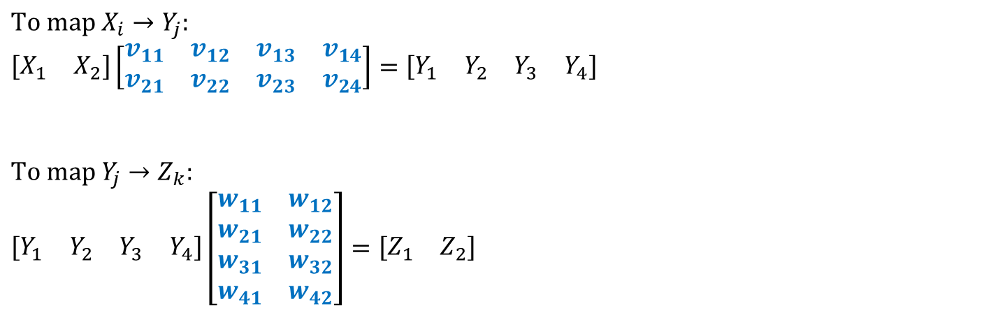
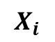


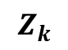
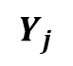
More Complicated Neural Network
Input
Intermediate layers
Output
$$X_{i}$$
$$v_{ij}$$
$$w_{jk}$$
$$Z_{k}$$
$$Y_{j}$$
$$To map X_{i}→Y_{j}:$$
$$\left[\begin{matrix}X_{1} & X_{2}\end{matrix}\right]\left[\begin{matrix}v_{11} & v_{12} & v_{13} & v_{14} \\ v_{21} & v_{22} & v_{23} & v_{24}\end{matrix}\right]=\left[\begin{matrix}Y_{1} & Y_{2} & Y_{3} & Y_{4}\end{matrix}\right]$$
$$To map Y_{j}→Z_{k}:$$
$$\left[\begin{matrix}Y_{1} & Y_{2} & Y_{3} & Y_{4}\end{matrix}\right]\left[\begin{matrix}w_{11} & w_{12} \\ w_{21} & w_{22} \\ w_{31} & w_{32} \\ w_{41} & w_{42}\end{matrix}\right]=\left[\begin{matrix}Z_{1} & Z_{2}\end{matrix}\right]$$
Notes:
https://docs.google.com/presentation/d/1XuyiyjRngEk5juZzX8NNos8VQp2_pcqvhIcfUi79yDI/edit#slide=id.i0

Slide 36
More Complicated Neural Network
Input
Intermediate layers
Output
$$X_{i}$$
$$v_{ij}$$
$$w_{jk}$$
$$Z_{k}$$
$$Y_{j}$$
$$To map X_{i}→Y_{j}:$$
$$\left[\begin{matrix}X_{1} & X_{2}\end{matrix}\right]\left[\begin{matrix}v_{11} & v_{12} & v_{13} & v_{14} \\ v_{21} & v_{22} & v_{23} & v_{24}\end{matrix}\right]=\left[\begin{matrix}Y_{1} & Y_{2} & Y_{3} & Y_{4}\end{matrix}\right]$$
$$To map Y_{j}→Z_{k}:$$
$$\left[\begin{matrix}Y_{1} & Y_{2} & Y_{3} & Y_{4}\end{matrix}\right]\left[\begin{matrix}w_{11} & w_{12} \\ w_{21} & w_{22} \\ w_{31} & w_{32} \\ w_{41} & w_{42}\end{matrix}\right]=\left[\begin{matrix}Z_{1} & Z_{2}\end{matrix}\right]$$
Transformations are done with matrix multiplications
Notes:
https://docs.google.com/presentation/d/1XuyiyjRngEk5juZzX8NNos8VQp2_pcqvhIcfUi79yDI/edit#slide=id.i0

Slide 37
Mid Session Break

Slide 38
MRC – Hypertension Modelling
Background:
Hypertension contributes to increased risk of stroke and heart attack
Early detection of hypertension may aid the development of preventative measures
We aim to identify trends and early indicators for hypertension to quantify progression in a population-wide dataset
Notes:
Trim down each point

Slide 39
Method – Pseudo Temporal Modelling
In a population-level cohort (such as the UK Biobank), participants fit into different stages of disease progression and represent the entire healthy-to-disease scale
Build a pseudo-temporal model using cross-sectional data to study the changes/progression of various biomarkers in patients from healthy to diseased
Assign a score (0 to 1) to reflect the degree of disease, in our case the severity of hypertension
“Trajectory inference” is the main method used

Slide 40
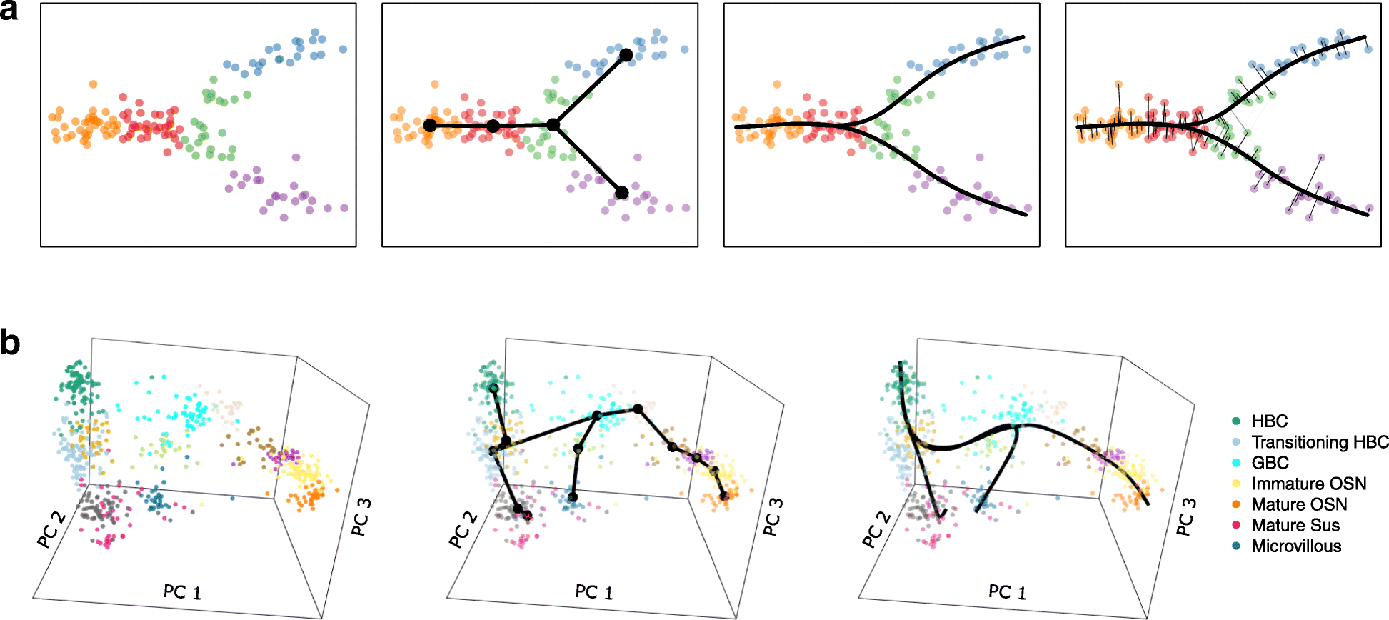
Trajectory Inference
Pseudo-temporal modelling to score patients based on their disease progression
Fits patients on “trajectories” of disease progression
Each trajectory may relate to changes in different combinations of biomarkers
Trajectory inference 2 main steps:
Dimensionality reduction of features
Connect each patient in the reduced dimensional space to form a minimum spanning tree
Notes:
Break down into 2 slides

Slide 41
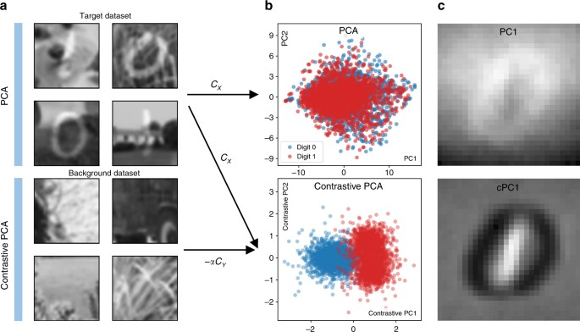
Contrastive Trajectory Inference (cTI)
“Contrastive” trajectory inference method to improve separation of pre-defined groups
Incorporate prior information (background/between/diseased) during the dimensionality reduction step of trajectory inference
Notes:
Break down into 2 slides

Slide 42
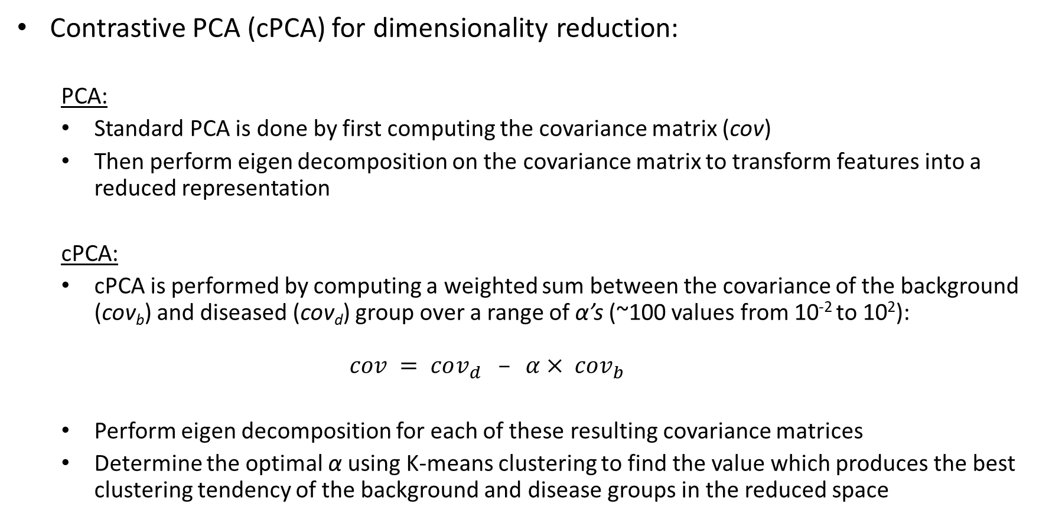
Contrastive Trajectory Inference (cTI) – Dimensionality Reduction
Contrastive PCA (cPCA) for dimensionality reduction:
PCA:
Standard PCA is done by first computing the covariance matrix (cov)
Then perform eigen decomposition on the covariance matrix to transform features into a reduced representation
cPCA:
cPCA is performed by computing a weighted sum between the covariance of the background (cov_{b}) and diseased (cov_{d}) group over a range of α’s (~100 values from 10⁻² to 10²): $cov = cov_{d} – α× cov_{b}$
Perform eigen decomposition for each of these resulting covariance matrices
Determine the optimal α using K-means clustering to find the value which produces the best clustering tendency of the background and disease groups in the reduced space
Notes:
Break down into 2 slides

Slide 43
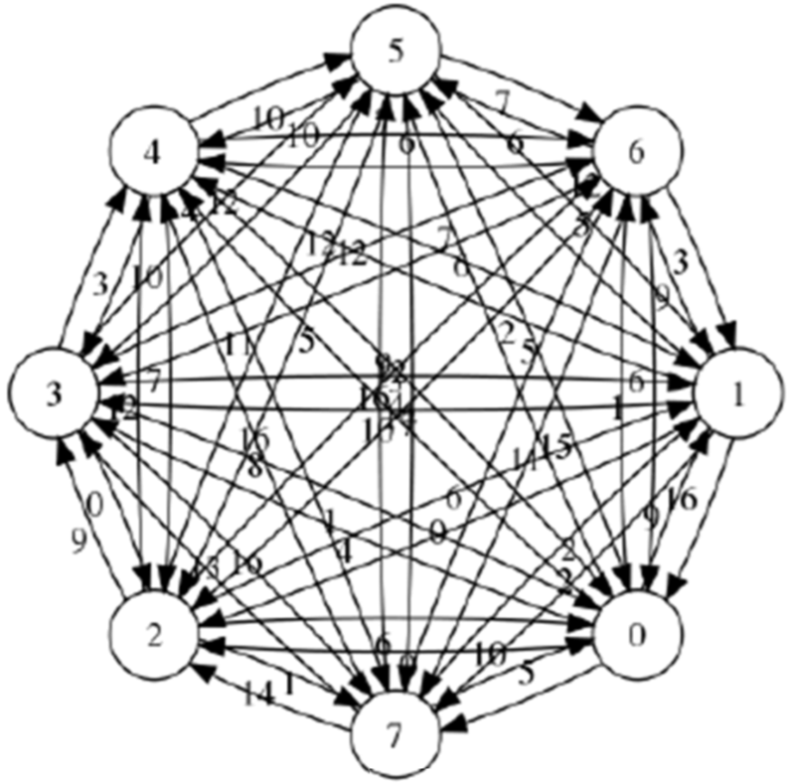
Contrastive Trajectory Inference (cTI) – Trajectory Construction
Consider each individual as a “node” in a complete graph in the contrastive principle component space (cPC)
Edge of the graph are defined by the Euclidean distance between nodes in the cPC space
Define “root node” as the node with the smallest overall distance in the cPC space from all nodes in in the population
Notes:
Break down into 2 slides

Slide 44
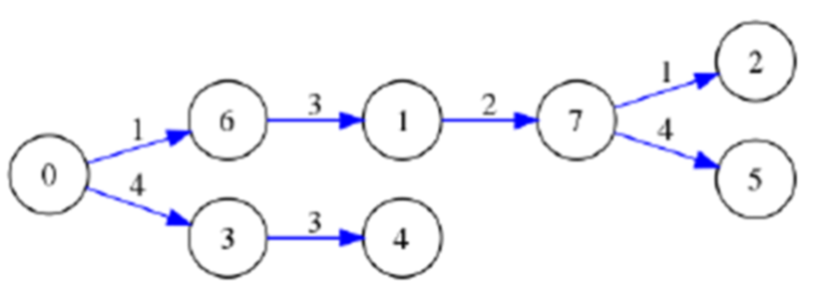
Contrastive Trajectory Inference (cTI) – Pseudo Time Score Calculation
Construct a minimum spanning tree which minimizes the overall distance between all nodes
Find the shortest path between each node and the root node
The disease (pseudo time) score is the normalized distance along the shortest path
Notes:
Break down into 2 slides

Slide 45
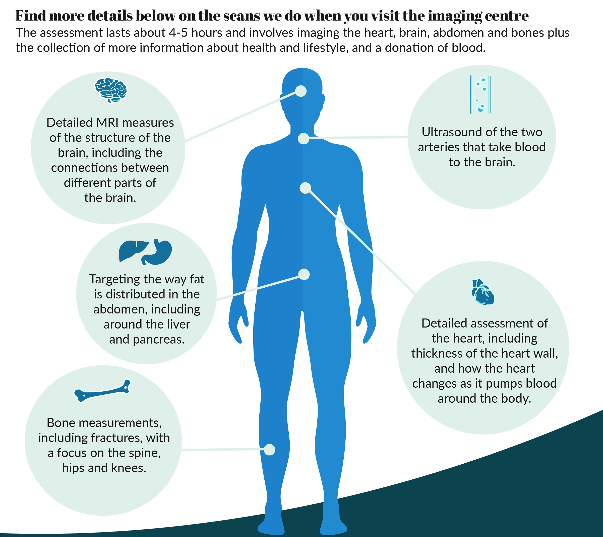
Study Population – UK Biobank
UK Biobank has around 500,000 participants from the general population
100,000 of these participants are planned to undergo medical imaging (cardiac MRI + brain MRI + carotid ultrasound)
UK Biobank contains ~15,000 features for each patient
Imaging patient dataset contains ~30,000 participants with ~2,000 imaging features
Aim:
Investigate the progression/change in features from the normotensive population to the hypertensive population
Notes:
Trim down each point

Slide 46
Data Pre-Processing
Filter out patients without blood pressure readings
Filter out variables which are not related to imaging/baseline measures
Remove participants who have already experienced a heart attack, angina or stroke before the time of imaging
Filter columns/rows with too many missing values
Remove outliers
Perform z-score normalization
Adjust for age/sex
Notes:
Break down into 2 slides

Slide 47
Data Label Definition
Define blood pressure groups
Background: < 120/80 (both)
Disease: > 160/100 (either)
Between: Any patient otherwise
Tightening “background” group definition
Remove patients already diagnosed with high blood pressure
Remove patients on blood pressure medication
Remove patients that had a high blood pressure reading at any stage (3 visits)
The final data frame has 27,338 (participants) with 1,086 (features)
Distribution of samples: background = 1,380, Between = 21,759, Disease = 4,199
Notes:
Break down into 2 slides

Slide 48
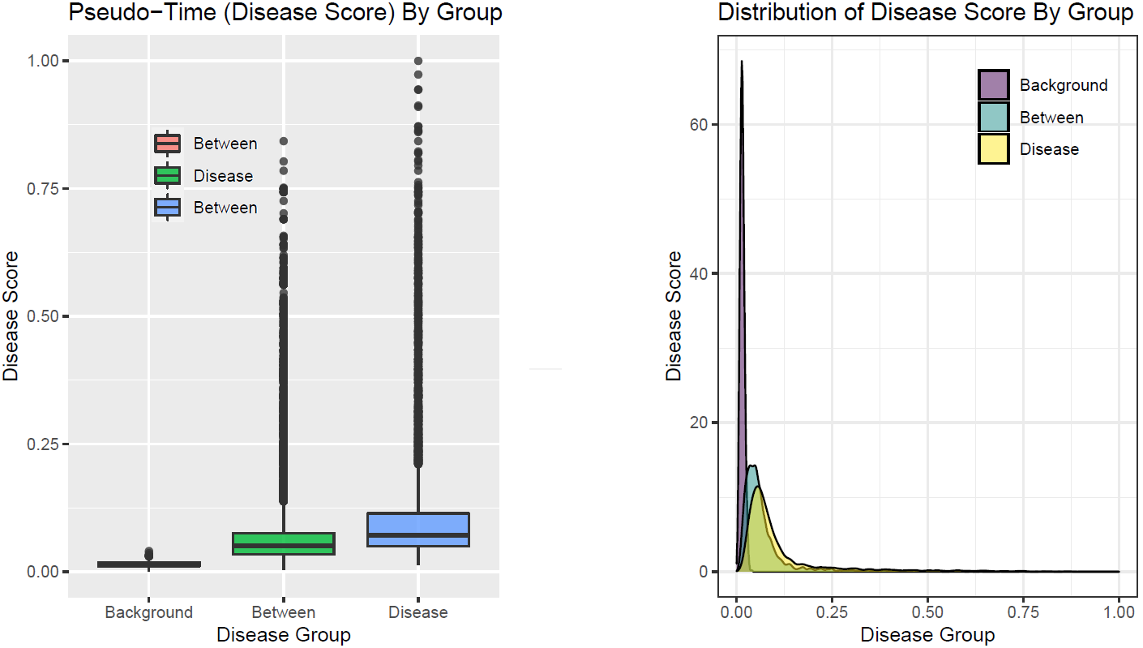
Main Results – Pseudotime Score
Notes:
Break down into 2 slides

Slide 49
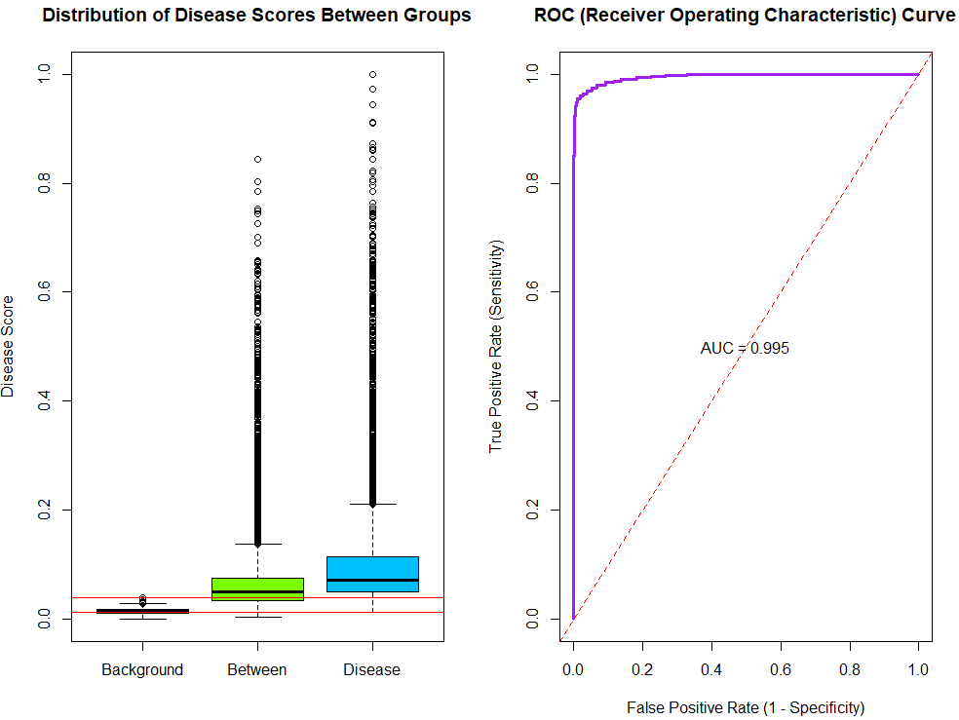
Evaluating the Accuracy of the cTI Model
AUC of 99.5% for distinguishing between “background” and ”diseased”
Sensitivity = 96.4%
Specificity = 97.2%
Optimal threshold = 0.027
Ground Truth
Background
Disease
96.4 | 2.8
3.6 | 97.2
Background
Prediction
Disease
0.040
0.014

Slide 50
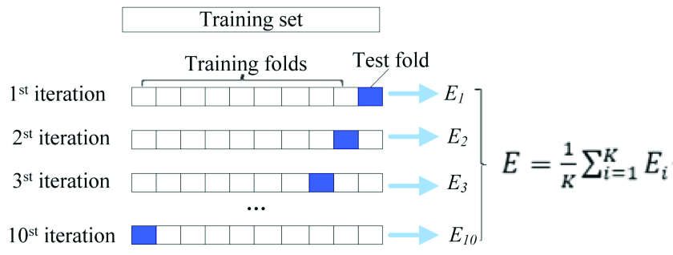
Evaluating the Stability of the cTI Model
Run the cTI model on 100% of the data to produce the set of baseline disease scores
Split dataset into 90:10 splits
Run cTI on 90% of the data to generate disease, ignore the 10% left out
Compare the scores generated from the subset dataset with those obtained from the full dataset
Repeat this for every 90:10 split (10-fold cross validation)
Overall 10-fold validation resulted in an RMSE of 0.04 (sd = 0.004)

Slide 51
Predicting Scores for New Patients
Place new patient in the current trajectory map from the existing cTI model
cTI generates a reduced representation (cPC) for the existing data
Transform new patient into the existing cPC space of the current cTI model
“Infer” the disease score as the score of the patient in the existing model with the smallest distance from a new patient in the cPC space
Advantages:
Don’t need to re-run cTI model
Nearest neighbor is easy to quantify when there are only ~15 cPCs

Slide 52
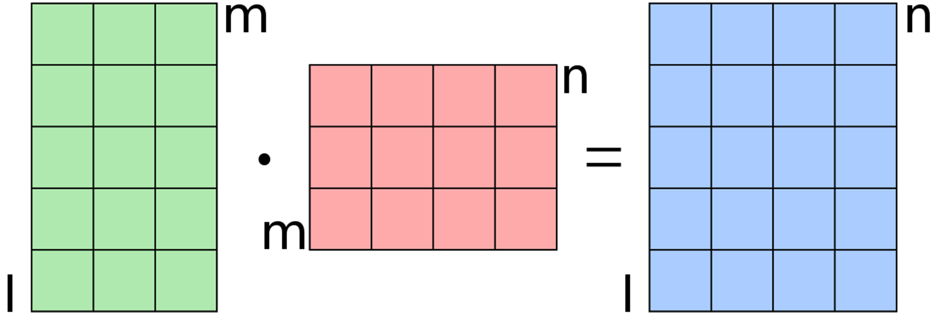
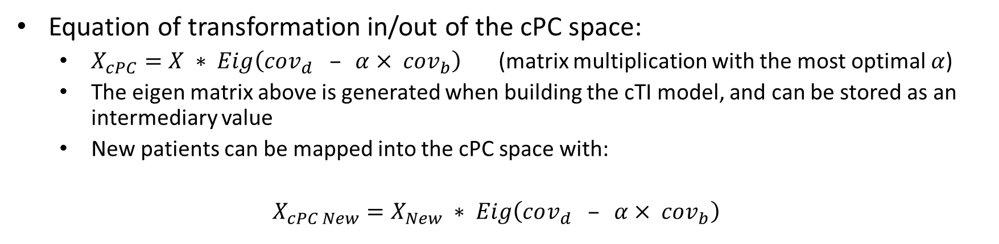
Implementation of cPC Transformation
Equation of transformation in/out of the cPC space:
$X_{cPC}=X ∗ Eig\left(cov_{d} – α× cov_{b}\right)$ (matrix multiplication with the most optimal $α$)
The eigen matrix above is generated when building the cTI model, and can be stored as an intermediary value
New patients can be mapped into the cPC space with:
$X_{cPC New}=X_{New} ∗ Eig\left(cov_{d} – α× cov_{b}\right)$
New Patient in cPC Space
New Patient(s)
Eigen Matrix

Slide 53
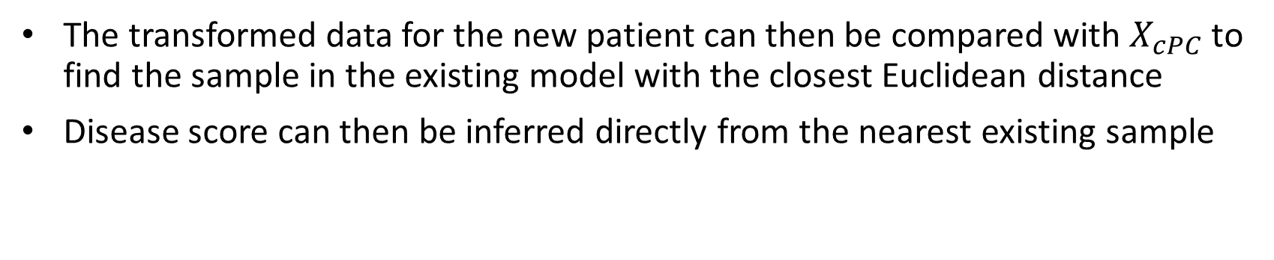
Implementation of cPC Transformation
The transformed data for the new patient can then be compared with $X_{cPC}$ to find the sample in the existing model with the closest Euclidean distance
Disease score can then be inferred directly from the nearest existing sample

Slide 54
Experimental Setup for Evaluating the “Prediction” Method
Run the cTI model on 100% of the data to produce the set of baseline disease scores
Split the data into 90% (training) and 10% (testing)
Use the 90% to train the cTI model
Use the proposed prediction approach to predict the 10% left out
Compare the predicted scores of the 10% with scores of the same patient in the 100% run
Repeat this for every 90:10 split (10-fold cross validation)

Slide 55
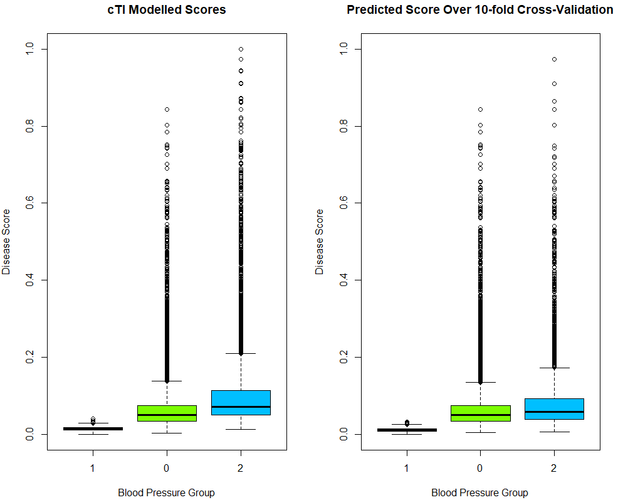
Experimental Results for “Prediction” Method
Predicted Scores Over 10-Folds of Cross-Validation
10-fold cross validation resulted in an RMSE of 0.043
Errors for each group were:
Background = 0.018 RMSE
Between = 0.085 RMSE
Disease = 0.094 RMSE
cTI Modelled Scores
Notes:
Split into 2 slides

Slide 56
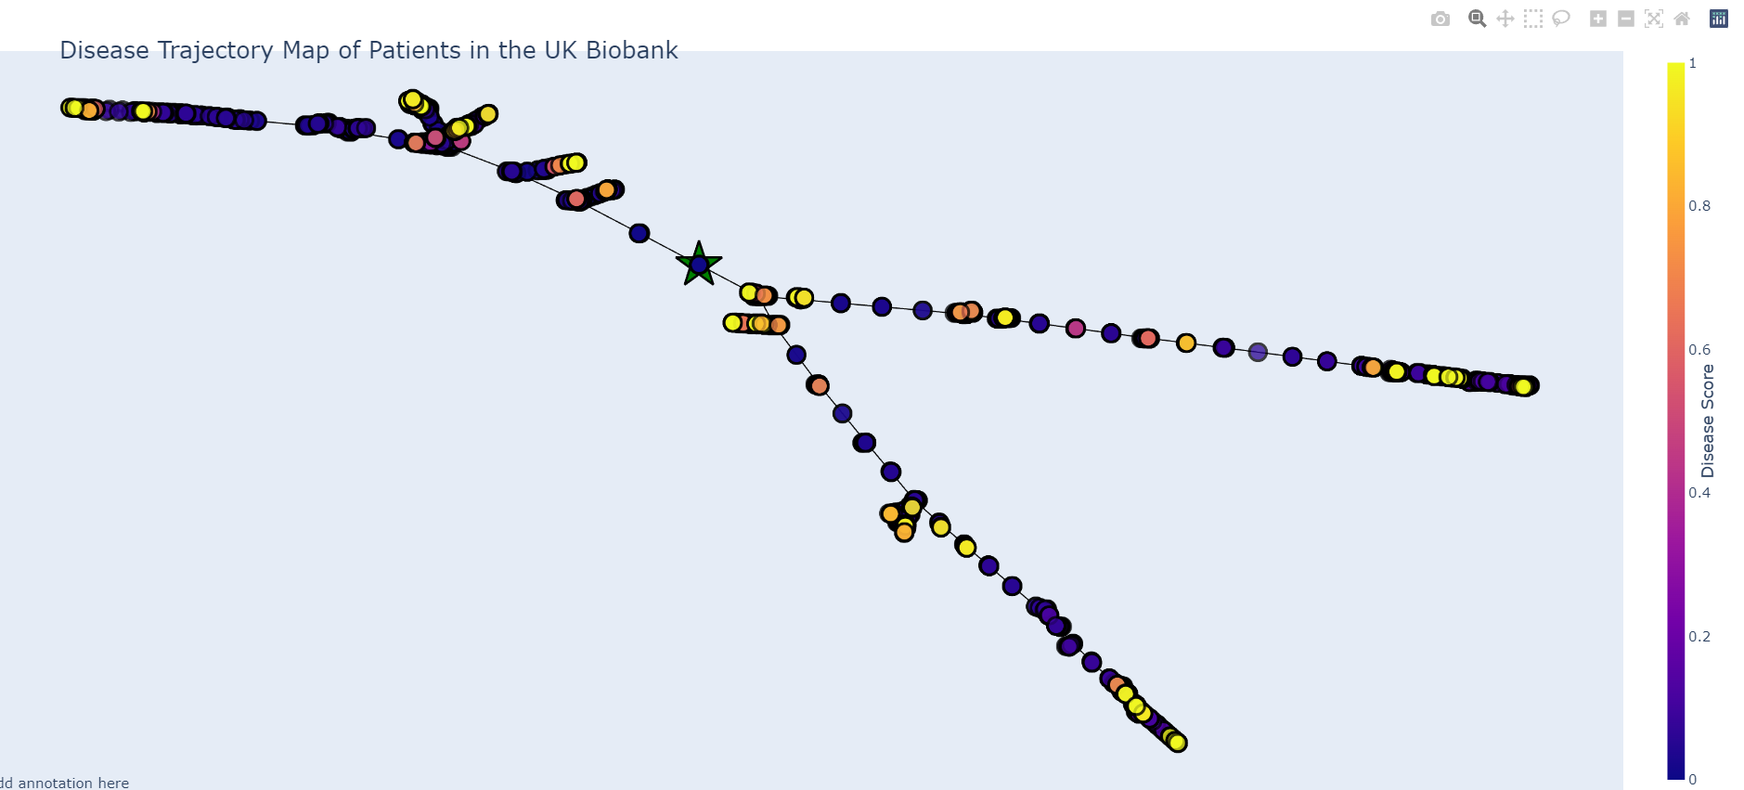
Trajectories – Preliminary Results
Compute the Laplacian of the matrix representation of the minimum spanning tree
Perform eigen decomposition on the Laplacian, the coordinates are thus the first two eigen vectors
Zoomed in Section
Notes:
Split into 2 slides

Slide 57
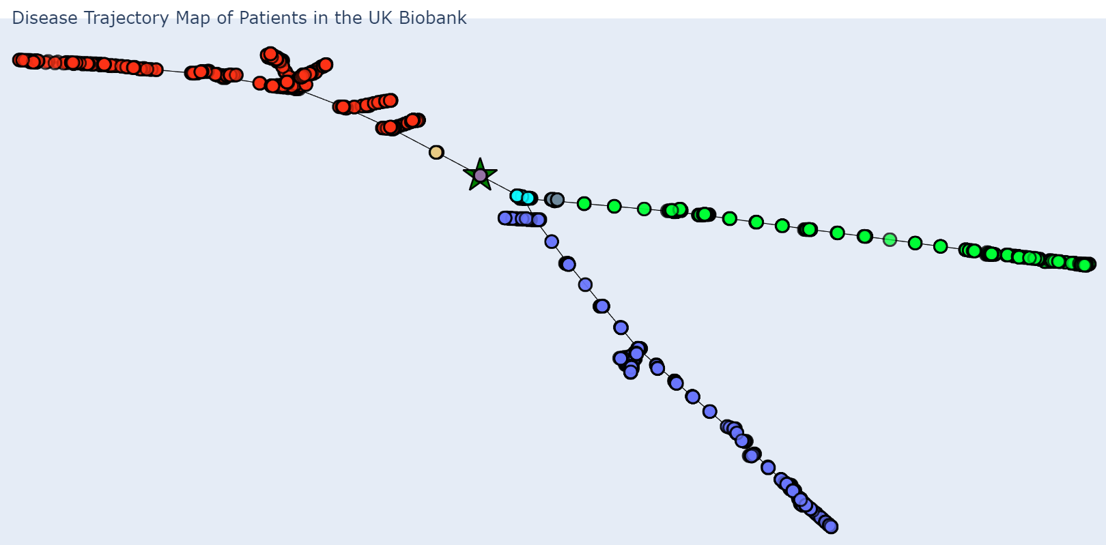
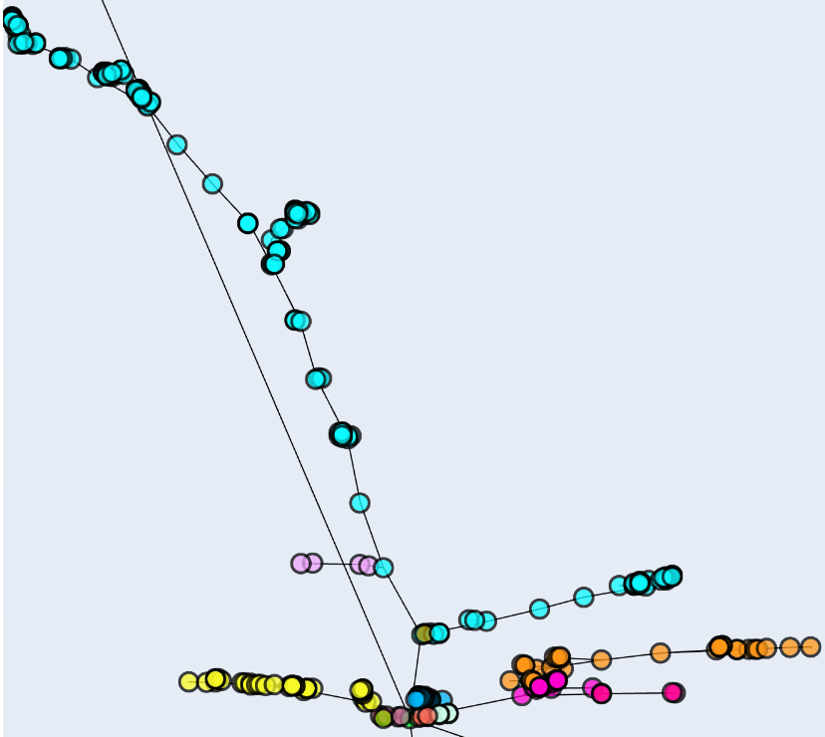
Trajectories – Preliminary Results
Color each unique trajectory
Many “unique” trajectories close to the root node due to low overlap
Notes:
Split into 2 slides

Slide 58
Future Work
Contrastive Trajectory Inference Model:
Improve score distribution in the model output
Understanding cTI Model:
Explore which variables contribute to elevated scores
Explore the change in these variables from healthy to disease
Trajectory Investigation:
Develop method to assign patients to a small number of “main” trajectories
Explore which variables are more significant in different trajectories

